Slide 1
Fire-Fighting Robot: Revolutionizing Fire Management and Safety

Slide 2
Project Overview:
Ladies and gentlemen, distinguished guests, and fellow enthusiasts, we are honored to present to you the culmination of our hard work and dedication - the ESP32-powered Fire-Fighting Robot. This exceptional creation represents the zenith of technological innovation, seamlessly integrating cutting-edge functionalities and intricate operational modes to autonomously combat fires while gathering critical environmental data. Today, we invite you to delve into the intricate details that make this robot a groundbreaking advancement in the realm of fire management and safety

Slide 3
Core Components of the Robot:
1) ESP32: The Intelligent Brain
Positioned at the heart of the robot, the ESP32 serves as both its computational powerhouse and its control hub with its advanced capabilities, it empowers the robot to make informed decisions and respond in real time to dynamic situations.

Slide 4
2) Drive Mechanism: Precision in Motion
Our robot's movement is orchestrated by a duo of DC motors, each meticulously controlled by a motor driver.The integration of couplers and wheels ensures not only precise movement but also stability, even in challenging terrains.To further enhance stability, a carefully engineered cluster wheel has been incorporated.

Slide 5
3) Power Systems: Uninterrupted Operation
The primary power source, a high-capacity 3600mAh 12V battery, forms the backbone of our robot's energy supply.To guarantee uninterrupted operations, an auxiliary power bank provides a steady stream of 5V power.The integration of a step-down converter is pivotal, as it meticulously regulates the voltage, efficiently converting the 12V input into a stable 5V output.

Slide 6
4) Structural Components: Durability and Mobility
The robust frame of the robot is constructed from resilient 3mm wood, meticulously designed to ensure a balance between durability and lightweight mobility.For specialized tasks, specific components have been 3D-printed, showcasing our commitment to both functionality and innovation.Notably, certain parts of utmost importance have been meticulously crafted from plastic, with a particular component designed to hold a servo made from a specialized 70% plastic material.

Slide 7
5) Sensor Suite: Environmental Awareness
Our robot is endowed with a sophisticated sensor suite, offering a heightened level of environmental awareness critical to its operations.This suite includes an ultrasonic sensor, enabling a comprehensive 180-degree obstacle detection and avoidance mechanism.Furthermore, twin flame sensors, an MQ-4 gas sensor, and a temperature sensor collectively empower the robot with a holistic understanding of its surroundings

Slide 8
6) Actuators: Precise Movement
Two servo motors, one featuring metal gears for enhanced durability, bestow the robot with the ability to execute precise movements.This precision is paramount for tasks such as negotiating obstacles and engaging in efficient fire combat.

Slide 9
7) Interface Components: Real-time Visualization
A mini breadboard acts as the nerve center for seamless electrical connections, ensuring the robot's components work in harmony.The integration of an I2C-enhanced LCD provides a visually intuitive platform for real-time data visualization, a feature instrumental to our robot's operational transparency.

Slide 10
8) Fire Extinguishing Mechanism: Swift Fire Combat
In the event of a fire, the robot deploys its fire extinguishing mechanism, activated with utmost precision by a servo motor. This mechanism, intricately complemented by a specially designed 3D-printed part, ensures fires are tackled swiftly and efficiently, minimizing potential damage.

Slide 11
9) Additional Components: Secure Control
An accessible on/off switch grants immediate control over the robot's functions, serving as a failsafe mechanism when needed to guarantee the safety of the entire assemblage, our creation is securely housed within a robust 3mm wooden body, safeguarding both its intricate components and the environment it interacts with.

Slide 12
Key Modules of the Robot:
Optical Avoidance: Intelligent Navigation
One of our most remarkable accomplishments is the development of intricate algorithms that underpin our robot's intelligent navigation capabilities.Leveraging the capabilities of the ultrasonic sensor, capable of a full 180-degree swivel, our robot can meticulously map its surroundings, allowing it to identify and gracefully navigate around obstacles.This novel approach guarantees optimal and hazard-free movement, demonstrating the culmination of our efforts to ensure the robot's autonomy and safety.

Slide 13
Fire Detection and Combat: Swift Response
Our team's ingenuity shines in the algorithms meticulously crafted to address fire detection and combat.Harnessing the power of twin flame sensors, our robot rapidly identifies the presence of a fire, orchestrating its movement to achieve an optimal position for effective combat.Once positioned, the robot deftly triggers the fire extinguishing mechanism, showcasing its ability to swiftly and decisively respond to critical situations.

Slide 14
Data Transmission & Cloud Integration: Seamless Communication
Spearheading the project's technological integration, we have seamlessly integrated Flutter and ESP32 with Firebase, revolutionizing communication pathways.Through this integration, the robot is empowered to relay real-time data to Firebase, creating an unobstructed and continuous flow of information.This two-way communication ensures our robot's adaptability, as it remains receptive to commands and data from the applications it interacts with, thereby maintaining its dynamic operational profile

Slide 15
Mobile & Web Applications: Interactive Control
A hallmark feature of our project lies in the symbiotic interaction between our robot and the dedicated mobile and web applications we have meticulously developed using Flutter.These applications transcend mere data displays, doubling as control centers that empower operators to intervene, provide commands, and oversee operations in real time.This interface forms the bridge between human operators and the autonomous capabilities of our robot, truly redefining the dynamics of fire management and safety.

Slide 16
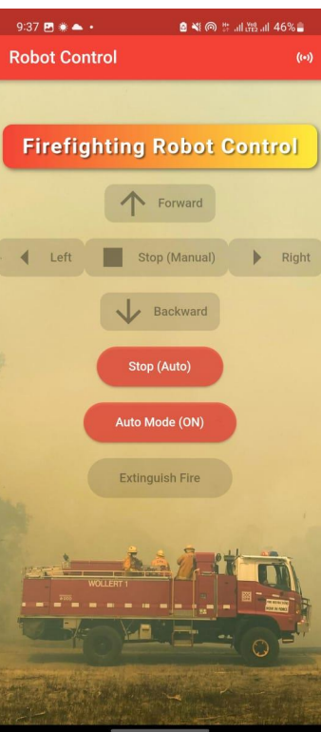

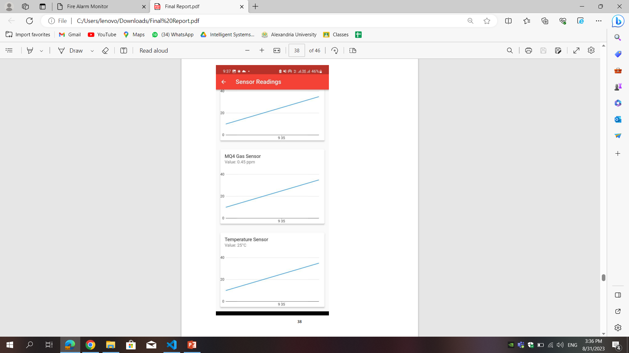
Our mobile Application:
This app featured an additional screen dedicated to displaying real-time sensor readings, including temperature, gas, and flame sensor data.

Slide 17
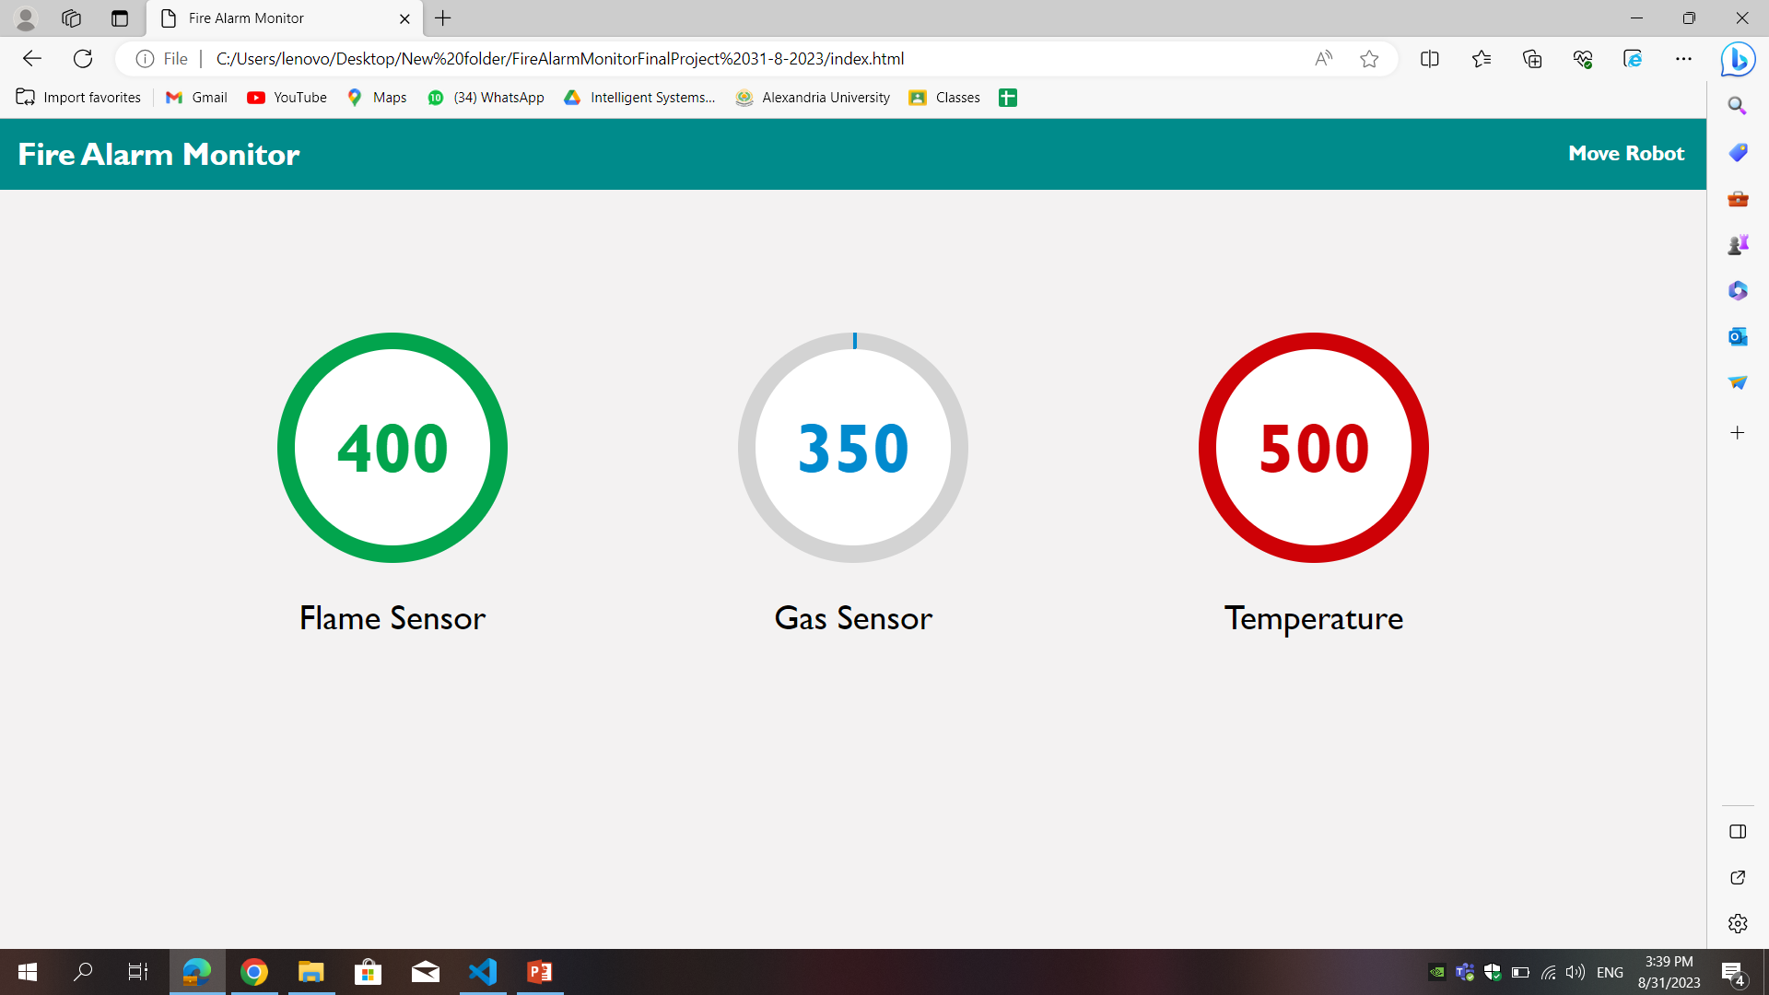
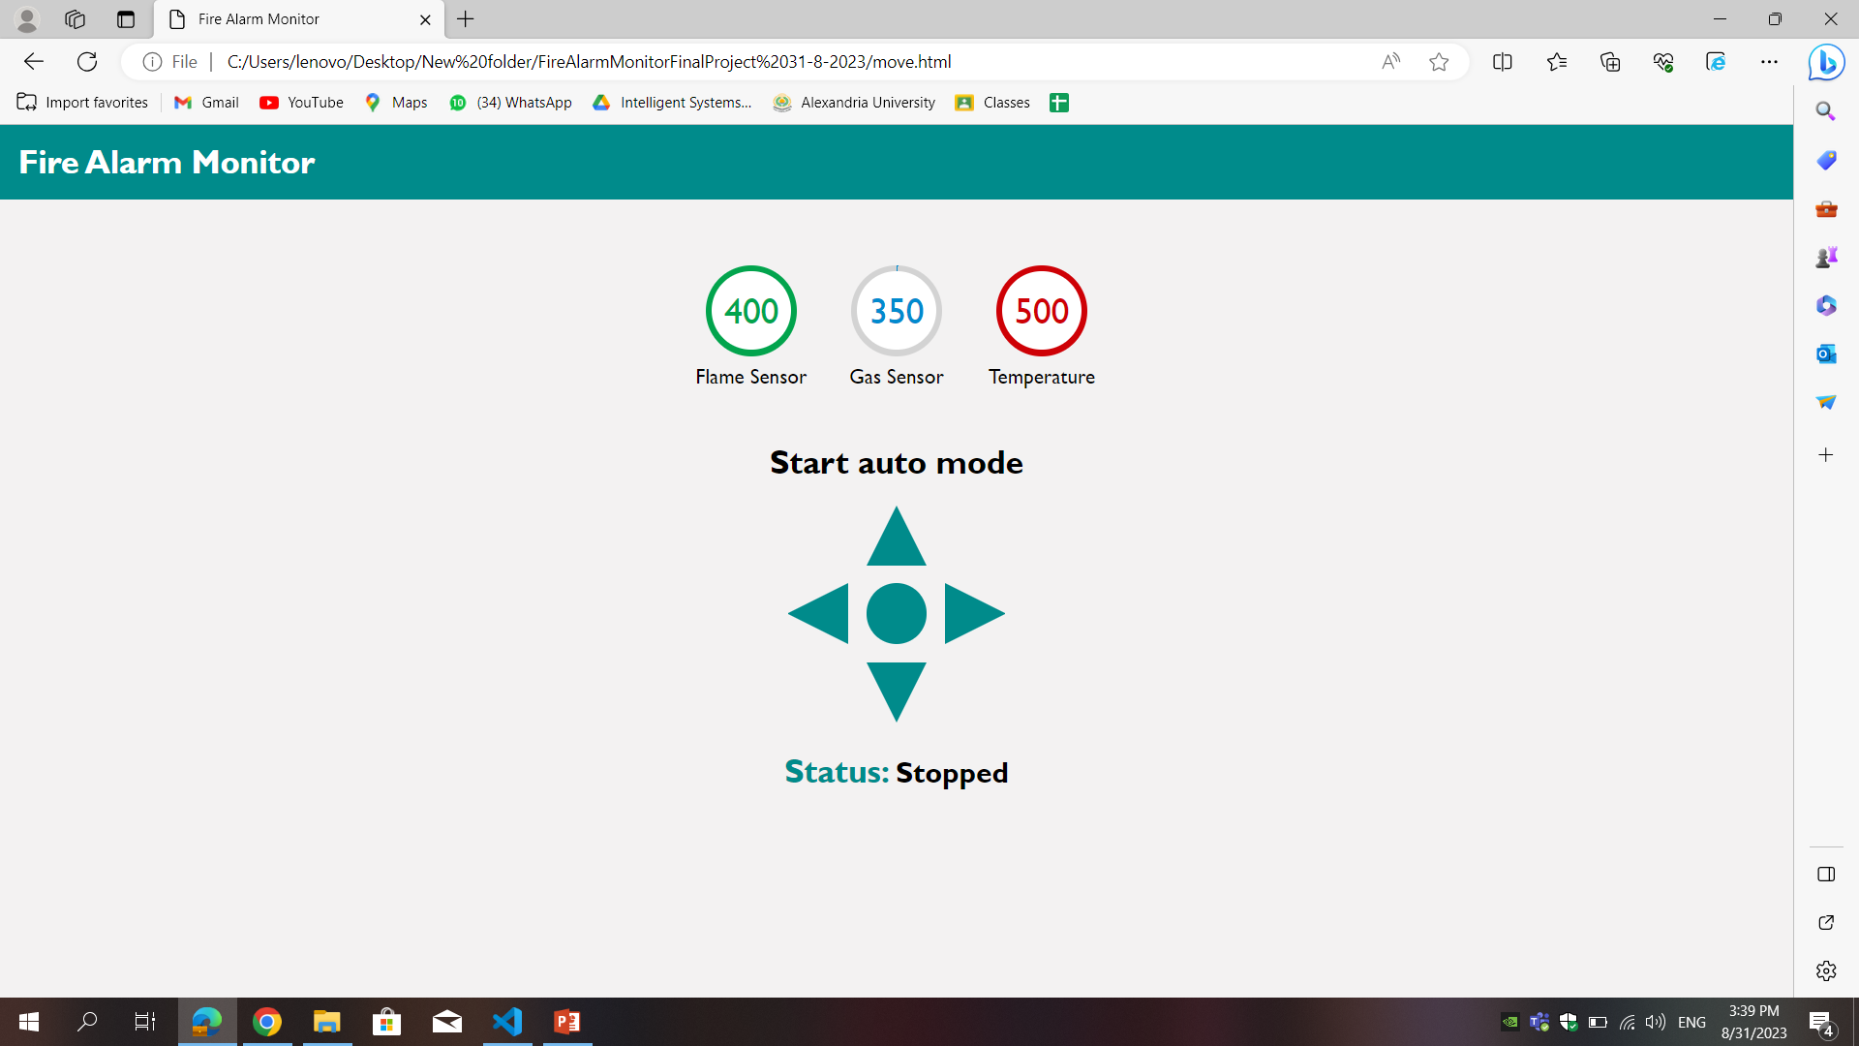
Our webstie:
It’s connected to firebase and shows sensors readings and controls robot

Slide 18
Conclusion:
In drawing the curtains on this presentation, we present a fire-fighting marvel that encapsulates the confluence of robotics, sensor technology, cloud integration, and interactive platforms. Our ESP32-powered Fire-Fighting Robot serves as a testament to our team's innovative prowess, technical acumen, and relentless dedication. It's not merely a creation but a solution that reimagines fire management and safety in an era defined by advanced technology. We extend our gratitude for your time and attention, and we eagerly anticipate the opportunity to demonstrate our robot's exceptional capabilities in the pursuit of effective fire management and enhanced safety.

Slide 19
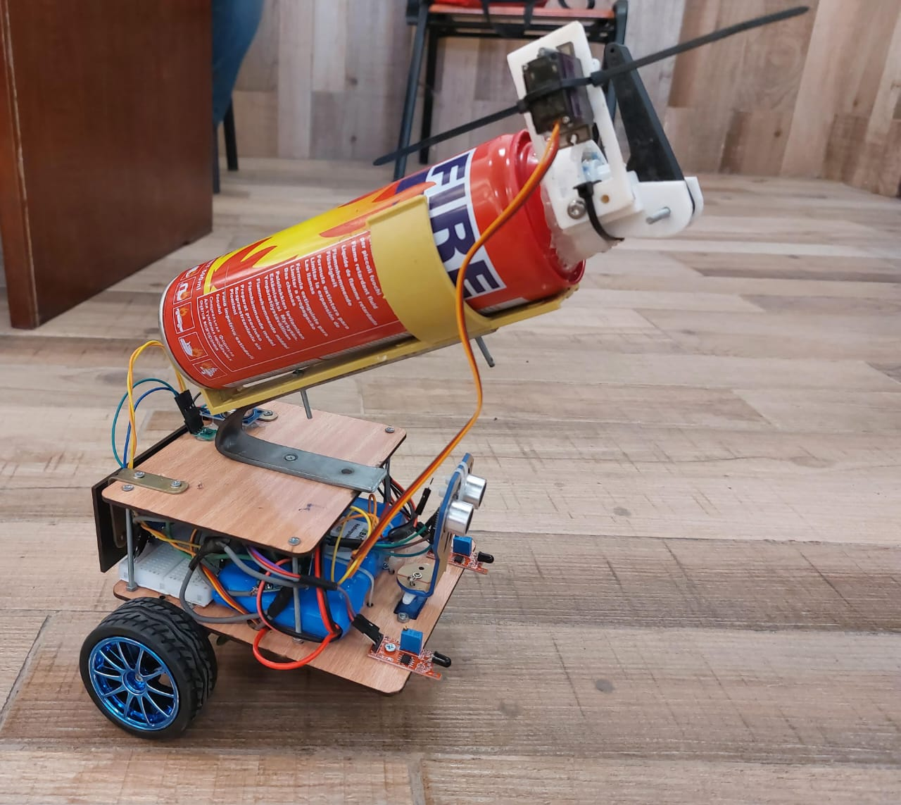
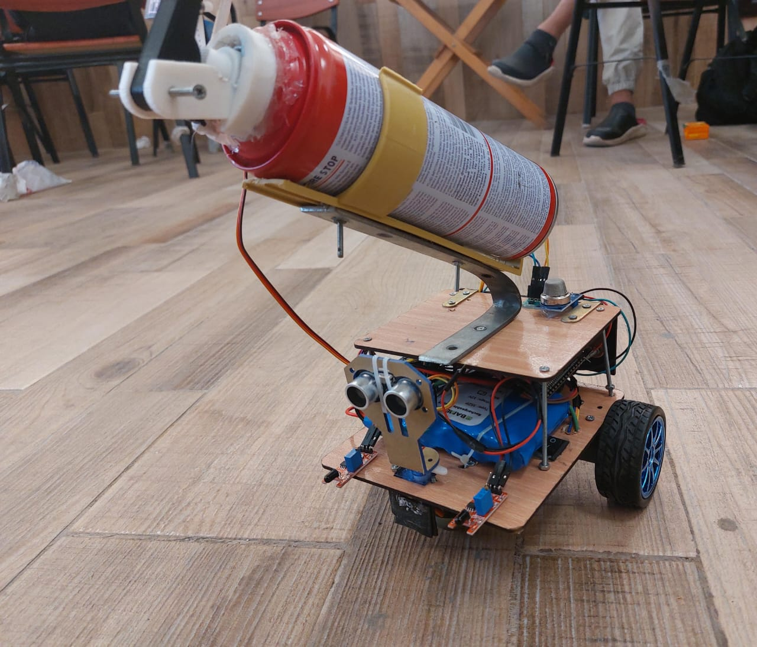
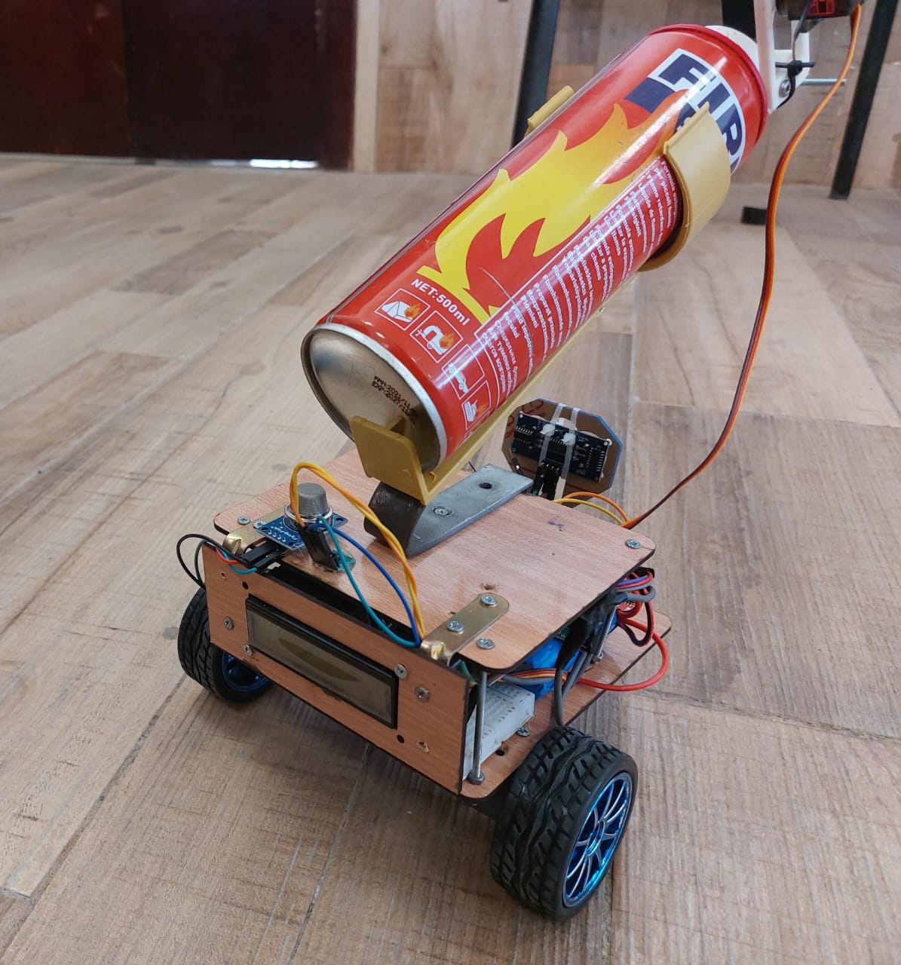
NB. Robot Cost = 2500 L.E

